Slide 1
Chi-Square (χ2) Test

Slide 2
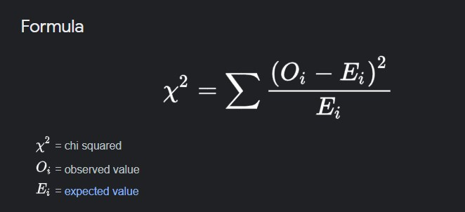
What is Chi-Square Test?
It is a Non-Parametric Significance Test.
Note: Non-Parametric Tests are applied when there is no exact information available about the population i.e. when we don’t know whether the population is binomial, Poisson, or normally distributed.

Slide 3
Why is it used?
Examine the degree of freedom between two categorical variables
Judge the goodness of fit between expected and observed results

Slide 4
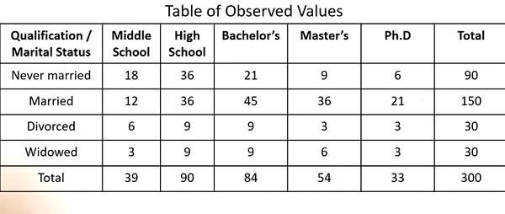
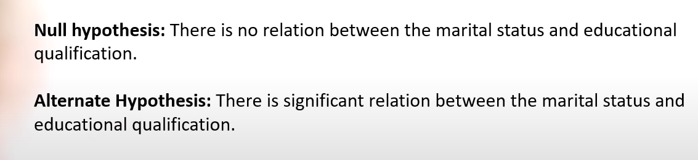
Significance Level(α) =0.05

Slide 5
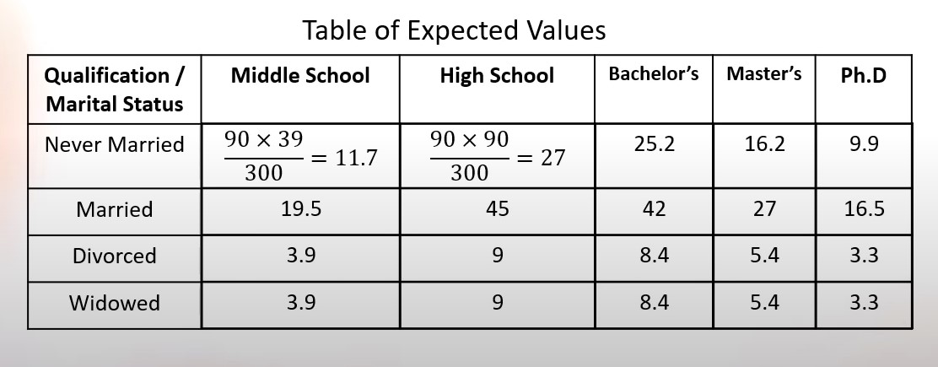

Slide 6
Degrees of Freedom
Degrees of freedom refer to the maximum number of logically independent values, which are values that have the freedom to vary, in the data sample.
Degrees of Freedom = (Columns -1)(Rows-1)

Slide 7
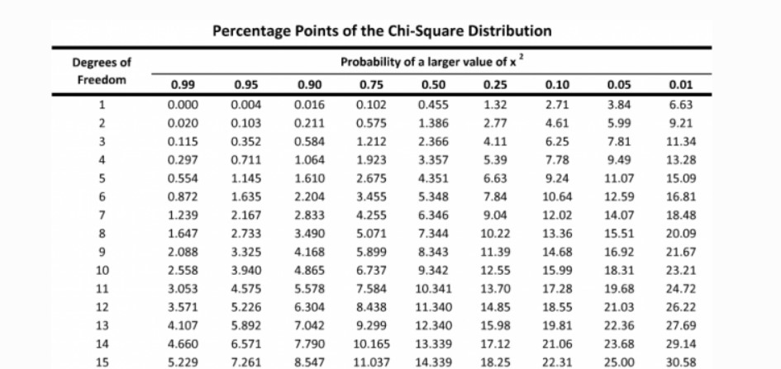

Slide 8
